Slide 1
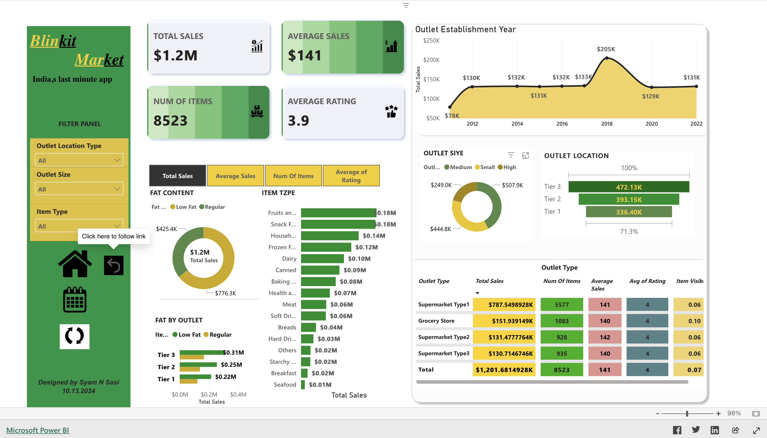
Power BI Dashboard

Slide 2


Blinkit Analysis 2024
Real time power BI Sales analytics
Designed by Syam N Sasi
13.10.2024

Slide 3
Objective
This project was cantered on building comprehensive analysis of Blinkit's sales performance, customer satisfaction, and inventory distribution to identify key insights and opportunities for optimization using various KPIs and visualizations in Power BI.

Slide 4
Steps in projects
Requirement Gathering/ Business Requirements
Data Walkthrough
Data Connection
Data Cleaning / Quality Check
Data Modelling
Data Processing
DAX Calculations
Dashboard Lay outing
Charts Development and Formatting v Dashboard / Report Development
Insights Generation

Slide 5
KPIs Requirements
﻿﻿﻿Total Sales: The overall revenue generated from all items sold.
﻿﻿﻿Average Sales: The average revenue per sale.
﻿﻿﻿Number of Items: The total count of different items sold.
﻿﻿﻿Average Rating: The average customer rating for items sold.

Slide 6
Business Requirements
﻿﻿﻿Total Sales by Fat Content: Objective: Analyse the impact of fat content on total sales. Additional KPI Metrics: Assess how other KPIs (Average Sales, Number of Items, Average Rating) vary with fat content. Chart Type: Donut Chart.
﻿﻿﻿Total Sales by Item Type: Objective: Identify the performance of different item types in terms of total sales. Additional KPI Metrics: Assess how other KPIs (Average Sales, Number of Items, Average Rating) vary with fat content. Chart Type: Bar Chart.
﻿﻿﻿Fat Content by Outlet for Total Sales: Objective: Compare total sales across different outlets segmented by fat content. Additional KPI Metrics: Assess how other KPis (Average Sales, Number of Items, Average Rating) vary with fat content. Chart Type: Stacked Column Chart.
﻿﻿﻿Total Sales by Outlet Establishment: Objective: Evaluate how the age or type of outlet establishment influences total sales. Chart Type: Line Chart.

Slide 7
﻿﻿﻿Sales by Outlet Size: Objective: Analyse the correlation between outlet size and total sales. Chart Type: Donut/ Pie Chart.
﻿﻿﻿Sales by Outlet Location: Objective: Assess the geographic distribution of sales across different locations. Chart Type: Funnel Map.
﻿﻿﻿All Metrics by Outlet Type: Objective: Provide a comprehensive view of all key metrics (Total Sales, Average Sales, Number of Items, Average Rating) broken down by different outlet types. Chart Type: Matrix Card.

Slide 8
• This project strengthened my technical and analytical capabilities, as well as my ability to manage projects effectively. I'm eager to apply these skills to future opportunities in data analytics and reporting.
Thanks to Data Tutorials (@datatutorials1) who guided me to create and learn this beautiful dashboard in power BI.

